Slide 1
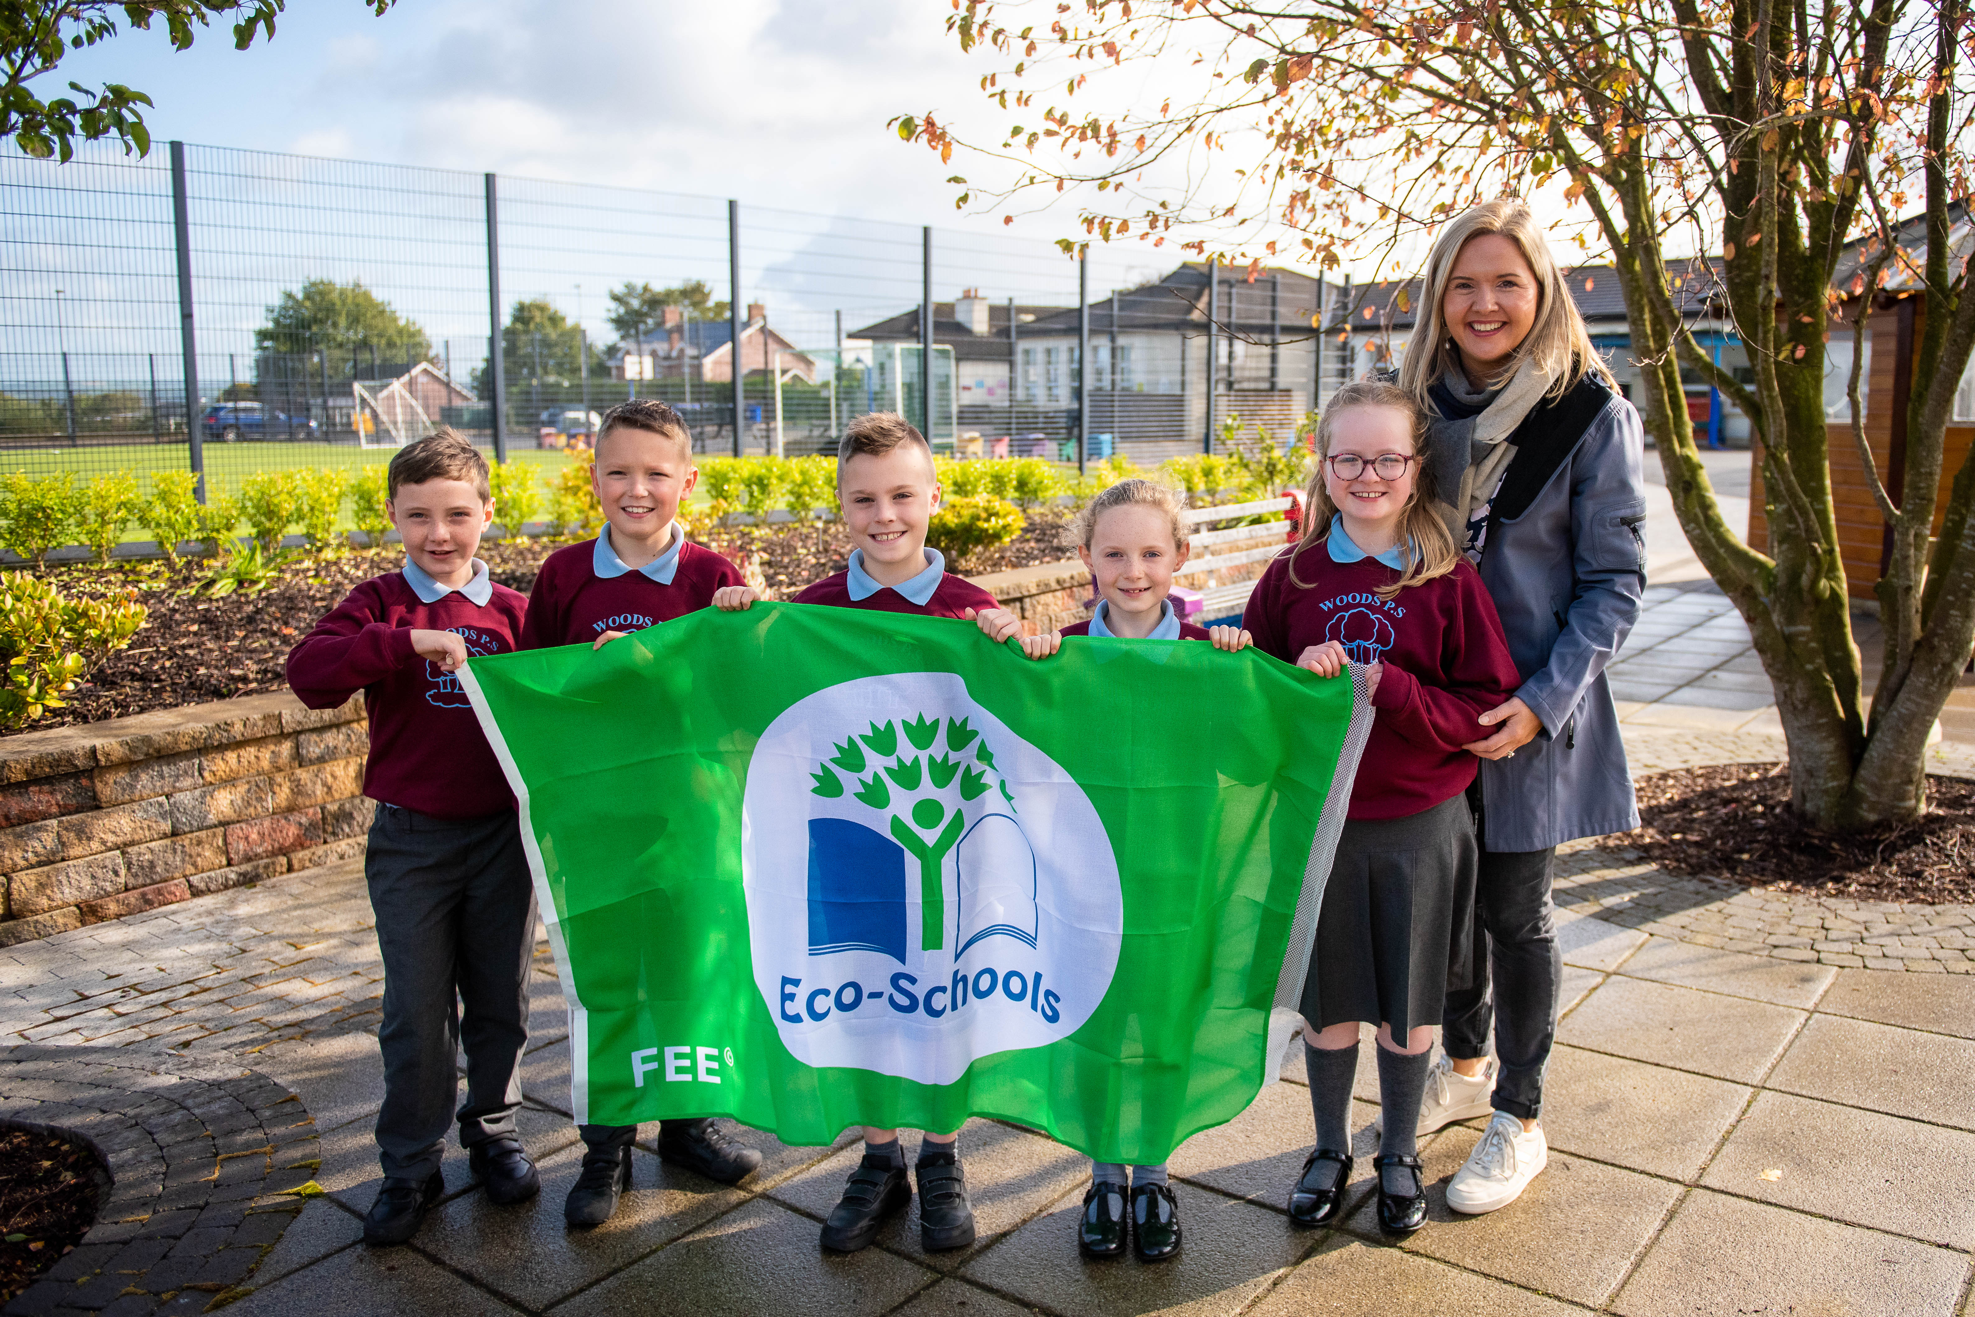
ECO ASSEMBLY
February 2024

Slide 2
OUR NEW MOTTO FOR 2024-25
Don’t be bitter, pick up your litter!

Slide 3
One of our targets this year is to eliminate litter from our school grounds.
We need your help! Don’t drop litter.
Help us to Keep our world clean and tidy
Use a bin when you are out and about and if there is no bin nearby then…. bring you rubbish home with you and put it in your own bin.

Slide 4
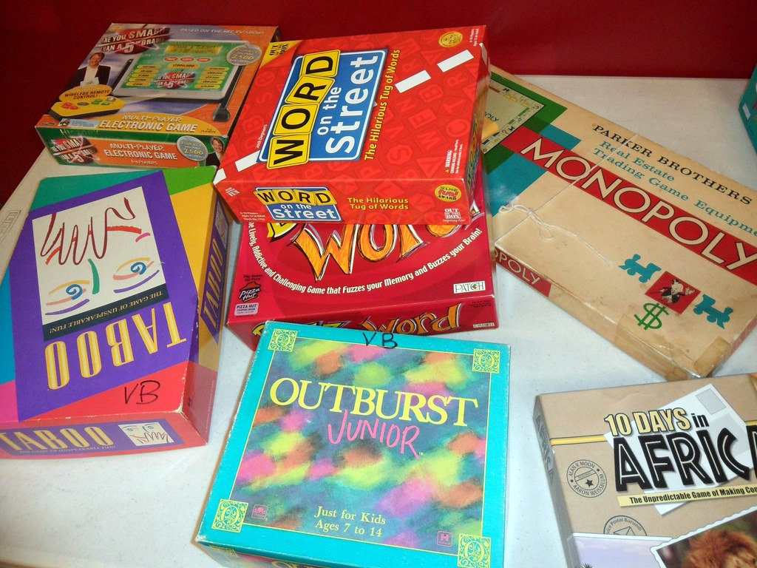
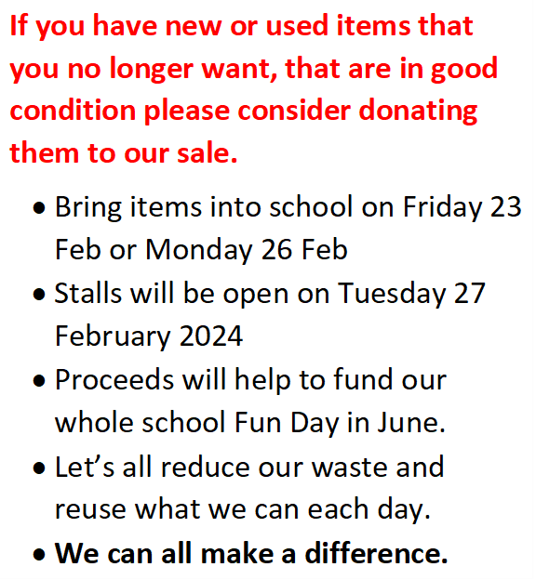
WHOLE SCHOOL EVENT ONE
This Photo by Unknown Author is licensed under CC BY-NC-ND

Slide 5
Another priority is to reduce the amount of single use plastic we use.
We want you to use reusable containers – refill water bottles and use small lunchboxes instead of plastic bags
Use reusable bags instead of plastic bags
Eat Healthy food and try to reduce buying food with plastic wrappers like crisps and chocolate bars
Help us to care for our environment and help us to reduce our carbon footprint

Slide 6
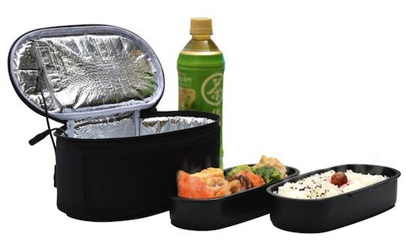
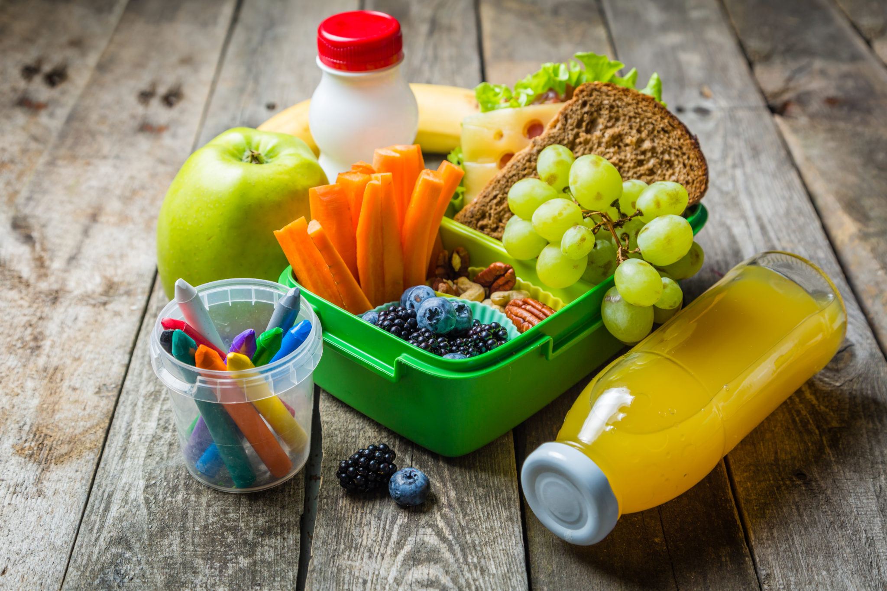
How can you help to be ECO friendly at lunchtime?
The LUNCH BOX
Challenge
This Photo by Unknown Author is licensed under CC BY-SA-NC
This Photo by Unknown Author is licensed under CC BY

Slide 7
Summary
Don’t drop litter – put it in the bin
Recycle and reuse as many items as you can
Bring used toys and books, you no longer want to our Toy and Book Sale (Bring items in on Friday or Monday)
Toy and Book Sale – Tuesday 27 February 2024
Make sure your lunch box is single use plastic free!
REMEMBER Don’t be Bitter – Pick up your litter!

